Slide 1
E-business
——The group of IKUN
Notes:
Generate By MotionGo-ChatPPT. Home：motion.yoo-ai.com AIGC 2023/4/26 10:27:49

Slide 2
Introduction of E-business
The origins and evolution of E-business.
Advantages of E-business
The challenge of E-business
The future development trend of E-business
Case study of E-business
Notes:
Generate By MotionGo-ChatPPT. Home：motion.yoo-ai.com AIGC 2023/4/26 10:27:49

Slide 3
01
Introduction of E-business
Overview of Business.
Notes:
Generate By MotionGo-ChatPPT. Home：motion.yoo-ai.com AIGC 2023/4/26 10:27:49

Slide 4
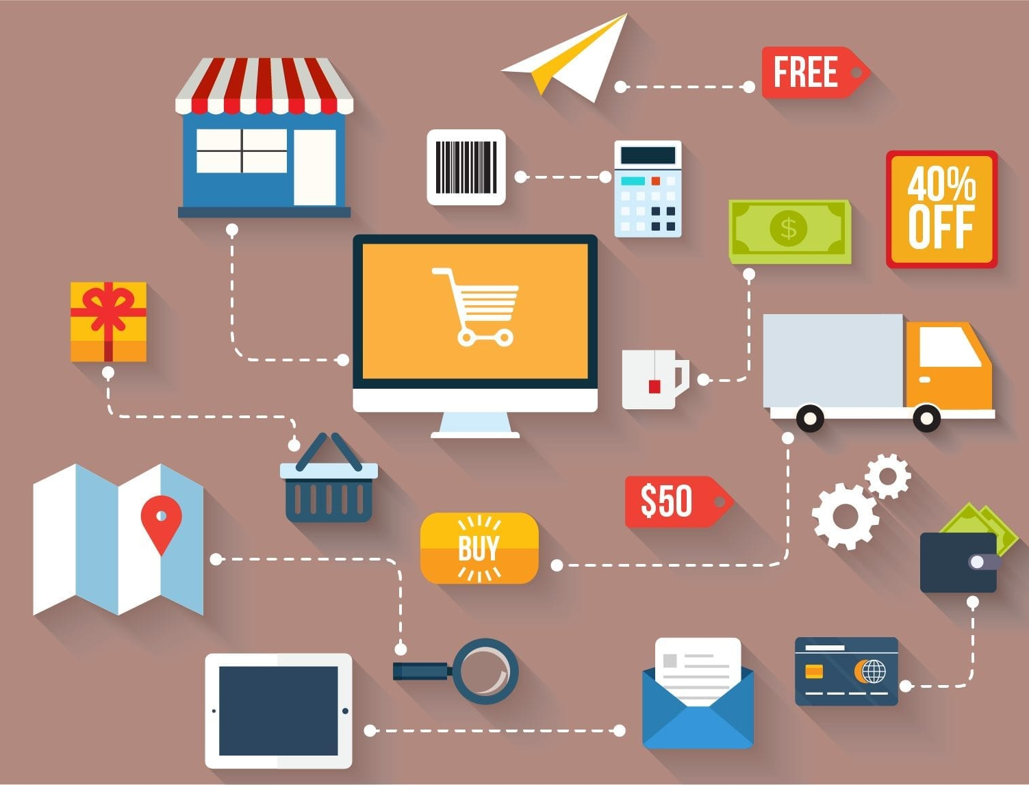
Definition of E-business
E-business, short for Electronic business, refers to the conduct of business activities, processes, and transactions - such as buying and selling goods and services, marketing and advertising, and customer service - over the Internet and other electronic networks.
Notes:
Generate By MotionGo-ChatPPT. Home：motion.yoo-ai.com AIGC 2023/4/26 10:27:49

Slide 5
History of E-business
The development of E-business can be traced back to the 1960s when companies began to use Electronic Data Interchange (EDI) to exchange business documents electronically.
In the 1990s, the Internet revolutionized E-business, making it accessible to a wider audience. The development of online marketplaces and shopping carts enabled businesses to sell products and services online, while digital marketing allowed them to reach customers more effectively.
The early 2000s saw the rise of cloud computing and Software as a Service (SaaS), which provided businesses with practical and cost-effective solutions for managing E-business operations.
Notes:
Generate By MotionGo-ChatPPT. Home：motion.yoo-ai.com AIGC 2023/4/26 10:27:49

Slide 6
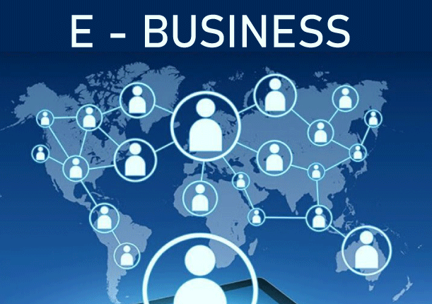
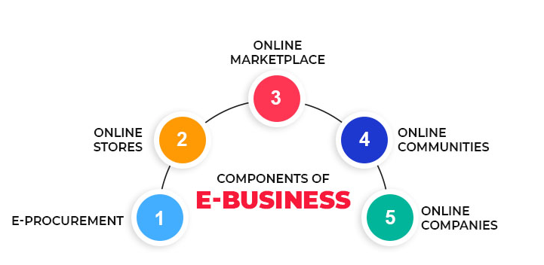
The impact of E-business on business models
E-business has had a significant impact on traditional business models.
One of the key benefits of E-business is the ability to remove geographic barriers, allowing businesses to reach a larger client base. This has led to the emergence of new business models, such as the e-commerce model, which allows businesses to conduct transactions over the internet.
Another significant impact of E-business has been the ability to streamline business processes and enhance supply chain management. Through the use of technology, businesses can automate many of their day-to-day functions, reducing costs and increasing efficiency.
Notes:
Generate By MotionGo-ChatPPT. Home：motion.yoo-ai.com AIGC 2023/4/26 10:27:49

Slide 7
02
The origins and evolution of E-business.
Notes:
Generate By MotionGo-ChatPPT. Home：motion.yoo-ai.com AIGC 2023/4/26 10:27:49

Slide 8



The first stage: In The first stage: In the mid-50s of the 20th century, the concept of "electronic business" appeared in the United States, which at that time referred to the use of electronic data processing equipment to automate bookkeeping. In 1964, IBM developed a printer that stored data with tape, introduced the concept of commercial word processing in the office for the first time, and developed a magnetic card printer for processing in 1969. By the mid-70s of the 20th century, industrialized countries have generally adopted commercial electronic equipment such as word processors, copiers, fax machines, and private exchanges, to realize the electronicization of individual commercial services.the mid-50s of the 20th century, the concept of "electronic business" appeared in the United States, which at that time referred to the use of electronic data processing equipment to automate bookkeeping. In 1964, IBM developed a printer that stored data with tape, introduced the concept of commercial word processing in the office for the first time, and developed a magnetic card printer for processing in 1969. By the mid-70s of the 20th century, industrialized countries have generally adopted commercial electronic equipment such as word processors, copiers, fax machines, and private exchanges, to realize the electronicization of individual commercial services.
The formation of e-business has gone through about three stages.
The first stage:
In the mid-50s of the 20th century, the concept of “electronic business” appeared in the US, which at that time referred to the use of electronic data processing equipment to automate
bookkeeping.By the mid-70s of the 20th century, industrialized countries have generally adopted commercial electronic equipment to realize the electronization of individual commercial services.
Notes:
Generate By MotionGo-ChatPPT. Home：motion.yoo-ai.com AIGC 2023/4/26 10:27:49

Slide 9



The second stage:
the development of microelectronics technology in the 70s of the 20th century, especially the emergence of personal computers. The electronic use of business has entered a new phase characterized by the application of microcomputers, word processing and local area networks. At this stage, electronic business systems based on computer, network communication and data standards came into being.
Notes:
Generate By MotionGo-ChatPPT. Home：motion.yoo-ai.com AIGC 2023/4/26 10:27:49

Slide 10

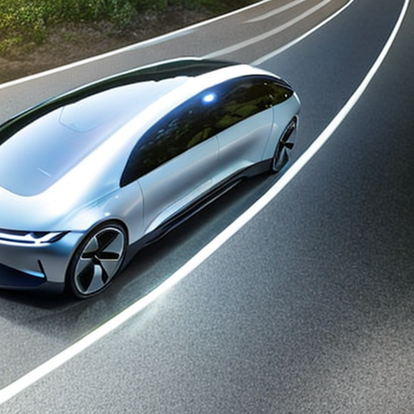
The third stage:
From the late 80s of the 20th century, commercial electronics has developed in the direction of establishing digital networks such as commercial integrated services. With the research of electronic communication standards, the development of electronic data systems, and computers began to be used in the collection and processing of commercial data, the era of e-commerce has really come.
Notes:
Generate By MotionGo-ChatPPT. Home：motion.yoo-ai.com AIGC 2023/4/26 10:27:49

Slide 11
03
E-business的优势
Advantages of E-business.
Notes:
Generate By MotionGo-ChatPPT. Home：motion.yoo-ai.com AIGC 2023/4/26 10:27:49

Slide 12
Advantages of E-business.
Advantage 1: Convenient transaction methods
Advantage 2: Global market coverage
E-business enables customers to make purchases online, anytime and anywhere, without the need to physically visit a store or office. This convenience attracts more customers, especially those who prefer to shop from the comfort of their own homes. Additionally, e-business allows for various payment options such as credit cards, PayPal, or bank transfers, making transactions more flexible and accessible.
E-business transcends geographical boundaries, enabling businesses to reach customers worldwide. This means businesses can tap into new markets and target audiences, increase brand awareness and customer loyalty, and expand their customer base.
Notes:
Generate By MotionGo-ChatPPT. Home：motion.yoo-ai.com AIGC 2023/4/26 10:27:49

Slide 13
Advantages of E-business.
Advantage 3: Lower operating costs
Advantage 4: Increased sales
E-business eliminates the need for physical stores and offices, reducing overhead costs such as rent, utilities, and maintenance. Additionally, e-business enables businesses to automate certain processes, such as inventory management and order processing, reducing the need for manual labor.
E-business provides businesses with the opportunity to reach a wider audience, resulting in increased sales. E-business allows businesses to gather data and insights into customer behavior, which can be used to tailor marketing strategies and promotions to specific audiences, further increasing sales.
Notes:
Generate By MotionGo-ChatPPT. Home：motion.yoo-ai.com AIGC 2023/4/26 10:27:49

Slide 14
04
E-business的挑战
The challenge of E-business.
Notes:
Generate By MotionGo-ChatPPT. Home：motion.yoo-ai.com AIGC 2023/4/26 10:27:49

Slide 15
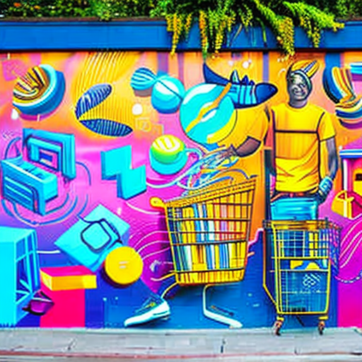
Security issues:
As e-businesses rely more on technology, they also face security threats such as hacking(黑客), phishing(网络钓鱼), and identity theft(身份盗用). To protect sensitive customer data and ensure secure transactions, companies need strong security measures.
Legal and regulatory issues:
E-businesses must follow various laws and regulations related to data protection, consumer protection, and taxation. Failure to comply with these laws can result in legal action, fines, and damage to reputation.
Explore Now
Read More
Notes:
Generate By MotionGo-ChatPPT. Home：motion.yoo-ai.com AIGC 2023/4/26 10:27:49

Slide 16

Intense market competition
It's easy to enter the e-business market, resulting in intense competition. Companies need to continuously innovate(创新) and differentiate themselves to remain competitive and attract and retain customers.
Consumer trust issues
E-businesses rely on customer trust for online transactions. However, incidents of data breaches(数据泄露) and scams(诈骗) have eroded(侵蚀) consumer trust in e-businesses. To overcome this challenge, companies need to establish a strong brand reputation, provide excellent customer service, and implement robust security measures.
Notes:
Generate By MotionGo-ChatPPT. Home：motion.yoo-ai.com AIGC 2023/4/26 10:27:49

Slide 17
05
The future development trend of E-business
Notes:
Generate By MotionGo-ChatPPT. Home：motion.yoo-ai.com AIGC 2023/4/26 10:27:49

Slide 18
The popularity of mobile Internet
With the popularity of mobile intelligent terminals, the consumption habits of China's mobile e-business users have gradually formed. Traditional e-business giants have laid out mobile e-business in succession, and numerous new mobile e-business shopping platforms continue to emerge. Under the influence of the epidemic in 2020, mobile terminal has been an important channel for the development of e-business platforms. With the outbreak of live streaming e-business market in recent years, the transaction scale of mobile e-business continues to upgrade.
Notes:
Generate By MotionGo-ChatPPT. Home：motion.yoo-ai.com AIGC 2023/4/26 10:27:49

Slide 19



Applications of big data and artificial intelligence
E-business has been developing strongly in recent years, and artificial intelligence has become a strong driving force.
eBay uses artificial intelligence to maintain consumer interest and enhance its competitive edge. eBay Shopbot uses natural language processing technology to find products that customers are interested in. Customers can communicate with the robot through text, voice and photos taken on their phones.
Notes:
Generate By MotionGo-ChatPPT. Home：motion.yoo-ai.com AIGC 2023/4/26 10:27:49

Slide 20
E-business and physical store integration development
As a physical store, it is difficult for a single channel to gain more profits in market competition. Only by integrating online and offline can stores better expand more market opportunities and promote turnover.
Notes:
Generate By MotionGo-ChatPPT. Home：motion.yoo-ai.com AIGC 2023/4/26 10:27:49

Slide 21
06
Case study of E-business
A case study of E-business
Notes:
Generate By MotionGo-ChatPPT. Home：motion.yoo-ai.com AIGC 2023/4/26 10:27:49

Slide 22
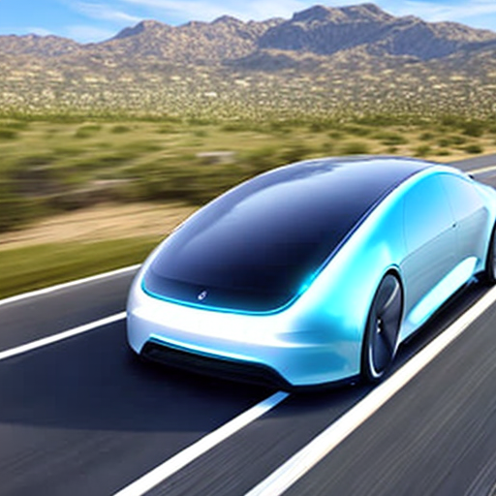

Alibaba
Alibaba is China's leading e-commerce company, founded in 1999 by Jack Ma. The company's main business is providing a platform for businesses to sell products online. Alibaba initially focused on the Chinese market, but has since expanded internationally, with operations in over 200 countries. One of the key factors contributing to Alibaba's success is its ecosystem strategy, which integrates various functions such as online marketplaces, payment services, logistics and cloud computing, under one platform. This enables the company to provide a seamless experience for its customers and partners, while also creating new revenue streams.
Tencent
Tencent is a Chinese conglomerate that operates a diverse portfolio of businesses, including social media, gaming, payments, and cloud services. Founded in 1998, Tencent rose to prominence with the success of its messaging app, WeChat, which has evolved into a super app with over 1 billion active users. Tencent's other highly successful businesses include gaming, music and video streaming, and mobile payments. The company has also made strategic investments in various companies across different industries, both within and outside of China.
Notes:
Generate By MotionGo-ChatPPT. Home：motion.yoo-ai.com AIGC 2023/4/26 10:27:49

Slide 23
Amazon
Amazon is one of the world's largest e-commerce companies, offering a broad range of products and services to customers worldwide. The company was founded in 1994 by Jeff Bezos, and has since grown to become one of the most successful online retailers in history. Amazon's success is largely due to its customer-centric approach, which prioritizes convenience, low prices, and fast delivery. The company has also invested heavily in developing its own technology, including artificial intelligence and machine learning, to enhance the customer experience and optimize operations.
Notes:
Generate By MotionGo-ChatPPT. Home：motion.yoo-ai.com AIGC 2023/4/26 10:27:49

Slide 24
THANKS
Notes:
Generate By MotionGo-ChatPPT. Home：motion.yoo-ai.com AIGC 2023/4/26 10:27:49

